Slide 1
Chapter 4
Standards Battles and Design Dominance

Slide 2
TEACHING OBJECTIVES
1. To increase students’ understanding of why a dominant design emerges and why it is not always the most technologically superior design that becomes dominant.
2. To identify the primary sources of increasing returns and network externalities.
3. To provide students with the tools needed to determine whether “winner-take-all” markets are good for consumers.
4. To provide students with a multidimensional model for assessing the value of a technology to buyers.

Slide 3
Overview
Many industries experience strong pressure to select a single (or few) dominant design(s).
There are multiple dimensions shaping which technology rises to the position of the dominant design.
Firm strategies can influence several of these dimensions, enhancing the likelihood of their technologies rising to dominance.
Notes:
3

Slide 4
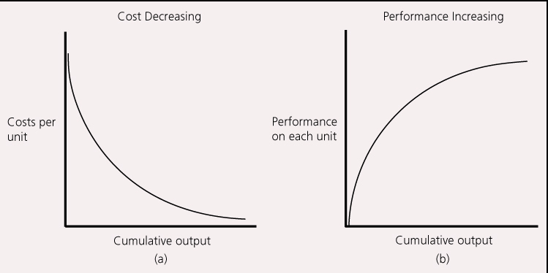
Why Dominant Designs Are Selected
Increasing returns to adoption
The more a technology is adopted ,the more valuable it becomes.
Two primary sources are learning effects and network externalities.
The Learning Curve: As a technology is used, producers learn to make it more efficient and effective.
Notes:
4

Slide 5

Network Externalities
The benefit from using a good increases with the number of other users of the same good.
Network externalities are common in industries that are physically networked
E.g., railroads, telecommunications
Network externalities also arise when compatibility or complementary goods are important
E.g., Many people choose to use Windows in order to maximize the number of people their files are compatible with, and the range of software applications they can use.
Notes:
5

Slide 6
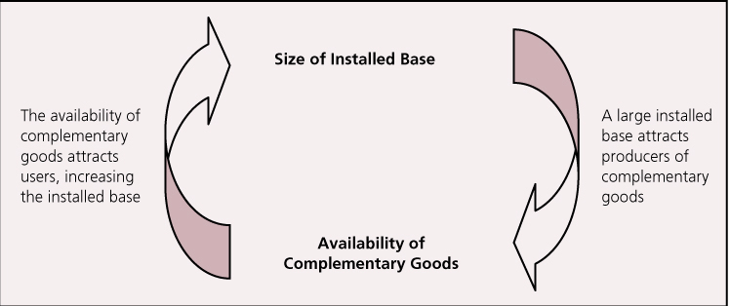
A technology with a large installed base attracts developers of complementary goods; a technology with a wide range of complementary goods attracts users, increasing the installed base.
A self-reinforcing cycle ensues:
Notes:
6

Slide 7
Government Regulation
Sometimes the consumer welfare benefits of having a single dominant design prompts government organizations to intervene, imposing a standard.
E.g., the NTSC color standard in television broadcasting in the U.S.; the general standard for mobile communications (GSM) in the European Union.
The Result: Winner-Take-All Markets
Natural monopolies
Firms supporting winning technologies earn huge rewards; others may be locked out.
Notes:
7

Slide 8
Increasing returns indicate that technology trajectories are characterized by path dependency:
End results depend greatly on the events that took place leading up to the outcome.
A dominant design can have far-reaching influence; it shapes future technological inquiry in the area.
Notes:
8

Slide 9
Multiple Dimensions of Value
In many increasing returns industries, the value of a technology is strongly influenced by both:
Technology’s Standalone Value
Network Externality Value
A Technology’s Stand-alone Value
Includes such factors as:
The functions the technology enables customers to perform
Its aesthetic qualities
Its ease of use, etc.
Notes:
9

Slide 10
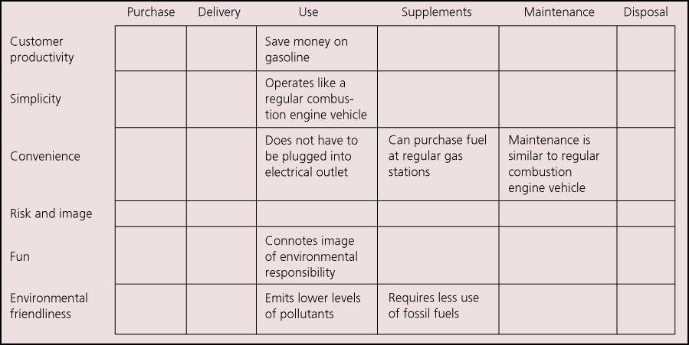
Multiple Dimensions of Value Continued
Kim and Mauborgne developed a “Buyer Utility Map” that is useful for identifying elements of a technology’s stand-alone value:
Notes:
10

Slide 11
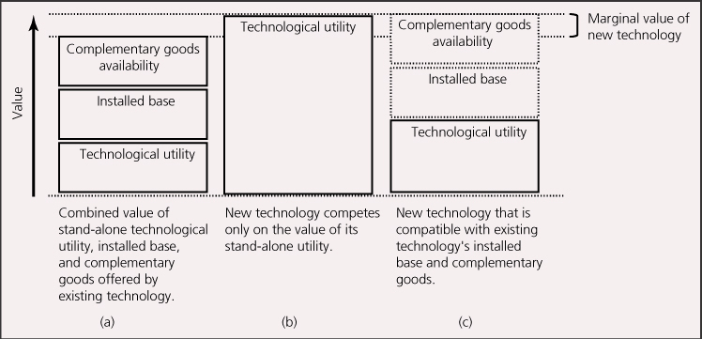
Network Externality Value
Includes the value created by:
The size of the technology’s installed base
The availability of complementary goods
Notes:
11

Slide 12
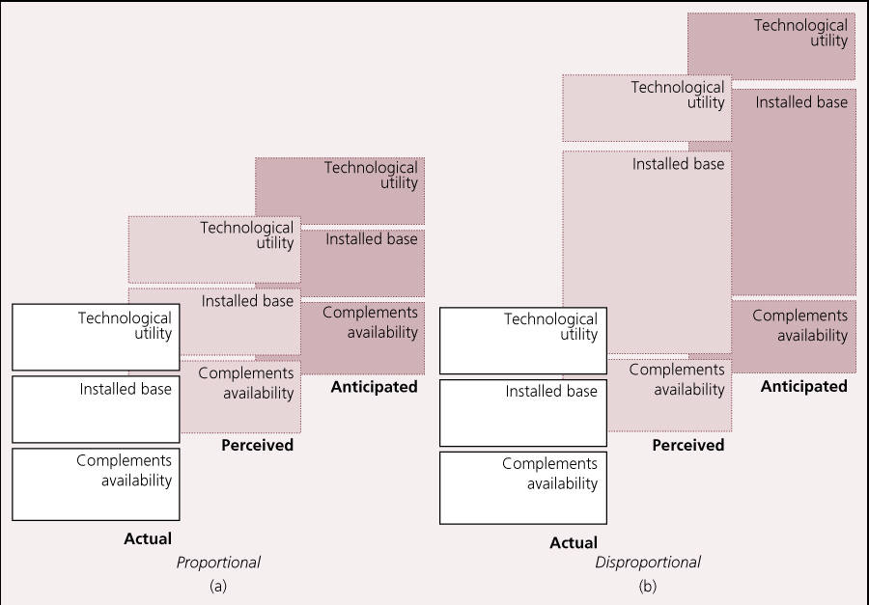
Subjective information (perceptions and expectations) can matter as much as objective information (actual numbers)
Value attributed to each dimension may be disproportional
Notes:
12

Slide 13
Competing for Design Dominance in Markets with Network Externalities
We can graph the value a technology offers in both standalone value and network externality value:
Value to Users
Value to Users
Value accrued from network externalities + Technology utility
Value accrued from network externalities
Tech. Value
Installed Base
Installed Base
Notes:
13

Slide 14
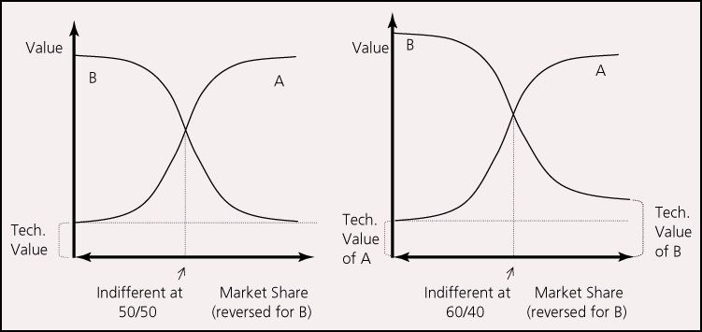
We can compare the graphs of two competing technologies, and identify cumulative market share levels (installed base) that determine which technology yields more value.
Notes:
14

Slide 15
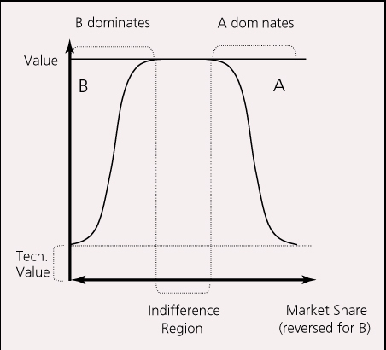
When customer requirements for network externality value are satiated at lower levels of market share, more than one dominant design may thrive.
Notes:
15

Slide 16
Ways to Expand Market Scale Quickly
1. Reduce the purchase cost of consumers and implement free gifts.
2. Reducing User's Learning Cost
Standardization of product interfaces and free training are common methods for enterprises. For example, Microsoft's office products all have roughly the same interface and operate in roughly the same way.
3. Take the lead in introducing products
In the 1980s, Apple and Microsoft were developing GUI operating system at the same time. Microsoft launched Windows first under immature technology, quickly occupied the market and became the dominant GUI operating system in one fell swoop.
4. Establishing alliance and developing technology.
5. Seeking help from venture capital

Slide 17
Lock-in strategy
Efforts to Increase Consumer Transfer Costs
Strengthen the technical training for their own products, so that the use style of their own products become the mainstream.
2. Make their products more distinctive, even make their products incompatible with competitors'products, so that consumers can not transfer data.
3. Provide integral discounts to consumers
Such as airline mileage plan.

Slide 18
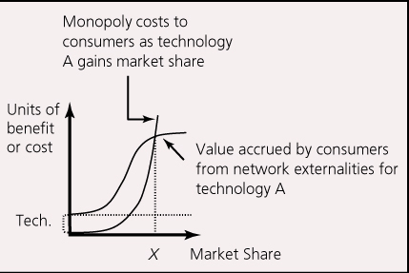
Are Winner-Take-All Markets Good for Consumers?
Network externality benefits to customers rise with cumulative market share
Potential for monopoly costs to customers (e.g., price gouging, restricted product variety, etc.) also rise with cumulative market share.
Curve shapes are different; Network externality benefits likely to grow logistically, while potential monopoly costs likely to grow exponentially.
Where monopoly costs exceed network externality benefits, intervention may be warranted. Optimal market share is at point where lines cross.
Notes:
18

Slide 19
Discussion Questions
1. What are some of the sources of increasing returns to adoption?
2. What are some examples of industries not mentioned in the chapter that demonstrate increasing returns to adoption?
3. What are some of the ways a firm can try to increase the overall value of its technology, and its likelihood of becoming the dominant design?
4. What determines whether an industry is likely to have one or a few dominant designs?
5. Are dominant designs good for consumers? Competitors? Complementors? Suppliers?
Notes:
19

Slide 20
Blu-Ray versus HD-DVD: A Standards Battle in High-Definition Video
From 2003 to 2008, Sony and Toshiba waged a high-stakes war for control over the next generation video format.
Sony’s Blu-Ray technology was backed by a consortium that included Philips, Matsushita, Hitachi, and others.
Toshiba’s HD-DVD had the backing of the DVD Forum, making it the “official” successor to the DVD format.
Both companies lined up major movie studios and video game consoles to promote their standards (Sony’s Playstation 3 and Microsoft’s Xbox 360).
In January 2008, Time Warner’s announcement that it would support Blu-Ray instead of HD DVD triggered a chain reaction that collapsed the support for HD-DVD. Toshiba announced it would cease production of HD-DVD equipment in February of 2008.
Notes:
20

Slide 21
Blu-Ray versus HD-DVD: A Standards Battle in High-Definition Video Contibued
Discussion Questions:
What factors do you think influenced whether a) consumers, b) retailers, or c) movie producers supported Blu-Ray versus HD-DVD?
Why do you think Toshiba and Sony would not cooperate to produce a common standard?
If HD-DVD had not pulled out of the market, would the market have selected a single winner or would both formats have survived?
Does having a single video format standard benefit or hurt consumers? Does it benefit or hurt consumer electronics producers? Does it benefit or hurt movie producers?
Notes:
21

Slide 22
Theory In Action
The Rise of Microsoft
In 1980, Microsoft didn’t even have a personal computer (PC) operating system – the dominant operating system was CP/M.
However, in IBM’s rush to bring a PC to market, they turned to Microsoft for an operating system and Microsoft produced a clone of CP/M called “MS DOS.”
The success of the IBM PCs (and clones of IBM PCs) resulted in the rapid spread of MS DOS, and an even more rapid proliferation of software applications designed to run on MS DOS. Microsoft’s Windows was later bundled with (and eventually replaced) MS DOS.
Had Gary Kildall signed with IBM, or had other companies not been able to clone the IBM PC, the software industry might look very different today!
Notes:
22

Slide 23
Theory In Action
The Rise of Microsoft
In 1980, Microsoft didn’t even have a personal computer (PC) operating system – the dominant operating system was CP/M.
However, in IBM’s rush to bring a PC to market, they turned to Microsoft for an operating system and Microsoft produced a clone of CP/M called “MS DOS.”
The success of the IBM PCs (and clones of IBM PCs) resulted in the rapid spread of MS DOS, and an even more rapid proliferation of software applications designed to run on MS DOS. Microsoft’s Windows was later bundled with (and eventually replaced) MS DOS.
Had Gary Kildall signed with IBM, or had other companies not been able to clone the IBM PC, the software industry might look very different today!
Notes:
23

Slide 24
Theory In Action
The Rise of Microsoft
In 1980, Microsoft didn’t even have a personal computer (PC) operating system – the dominant operating system was CP/M.
However, in IBM’s rush to bring a PC to market, they turned to Microsoft for an operating system and Microsoft produced a clone of CP/M called “MS DOS.”
The success of the IBM PCs (and clones of IBM PCs) resulted in the rapid spread of MS DOS, and an even more rapid proliferation of software applications designed to run on MS DOS. Microsoft’s Windows was later bundled with (and eventually replaced) MS DOS.
Had Gary Kildall signed with IBM, or had other companies not been able to clone the IBM PC, the software industry might look very different today!
Notes:
24

Slide 25
Refrences:
1、《网络经济学》（第2版），张小蒂 等编著，高等教育出版社，2008年4月
2、《网络经济学》（第2版），王晔 等主编，高等教育出版社，2013年12月
3、《信息规则-网络经济的策略指导》，（美）卡尔.夏皮罗 哈尔.瓦里安 著，张帆 译，中国人民大学出版社，2000年6月

